Slide 1
Unit III Library Functions
Chapter 15

Slide 2
Contents
Library Functions
Math
Process
Clone
System Functions

Slide 3
Library Functions
These are the inbuilt functions present in Java library classes, provided by Java system – to help programmers to perform their task in an easier way
These are called as Library Classes.
In Java support thousands of library classes and also each class contains various types of functions.
E.g.., Mathematical functions, Input/Output

Slide 4
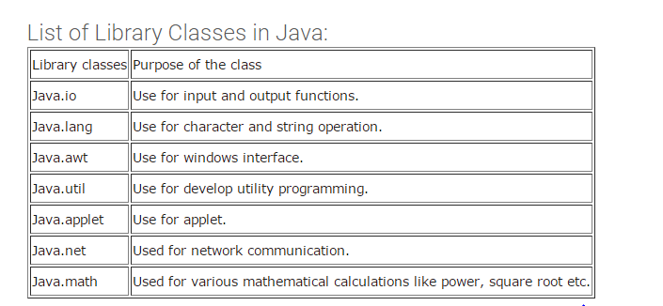
Library Classes in Java

Slide 5
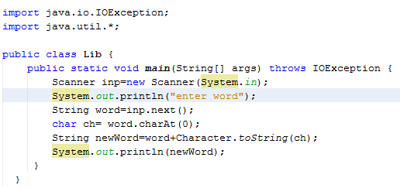

Example –using package import.java.util

Slide 6
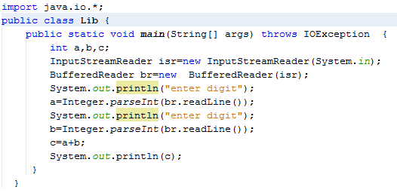
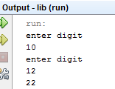
Example –using package import.java.io

Slide 7
Math Functions
The math class contains all the floating-point functions that are used for geometry and trigonometry.
It is classified into four functions:
Transcendental Functions
Exponential Functions
Rounding Functions
Miscellaneous Math Methods

Slide 8
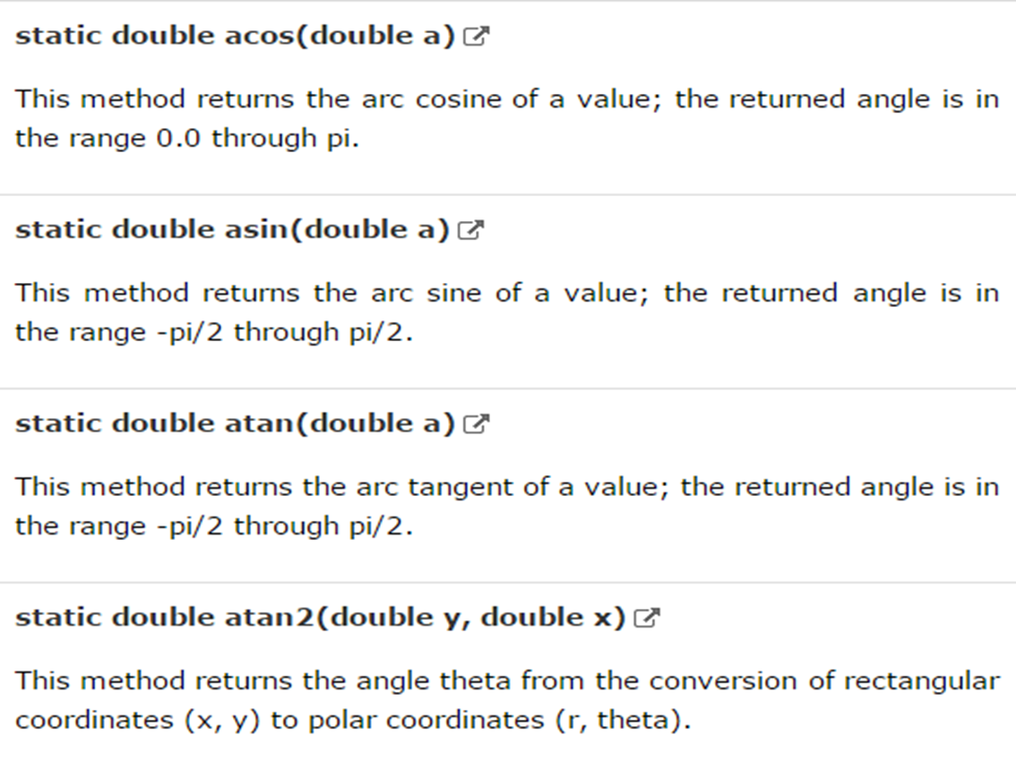
Transcendental Functions

Slide 9
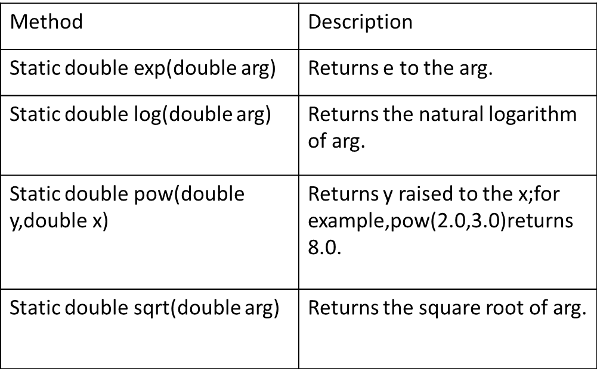
Exponential Functions

Slide 10
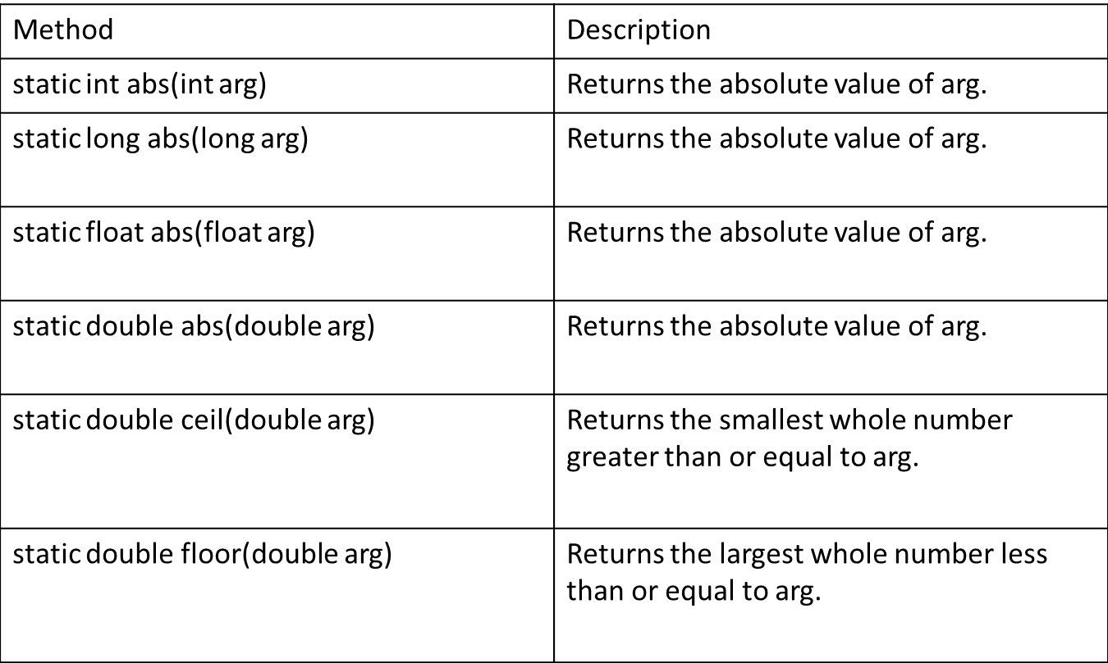
Rounding Functions

Slide 11
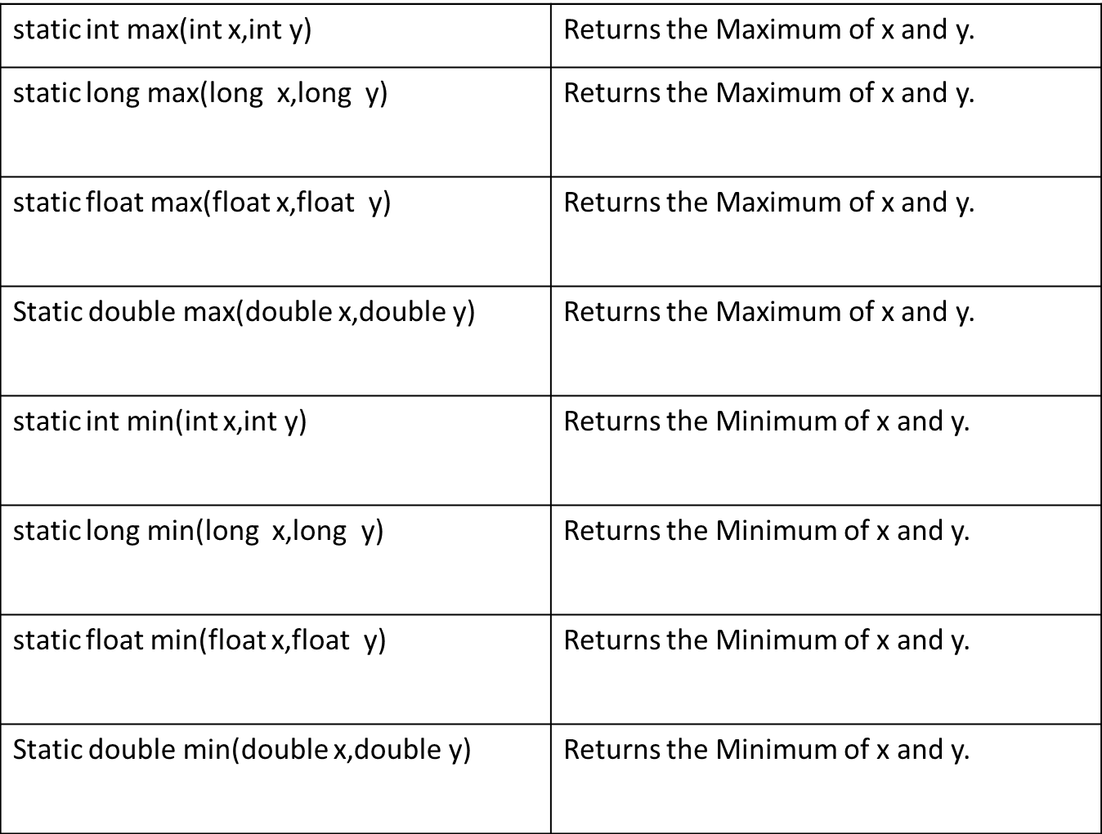
Rounding Functions

Slide 12
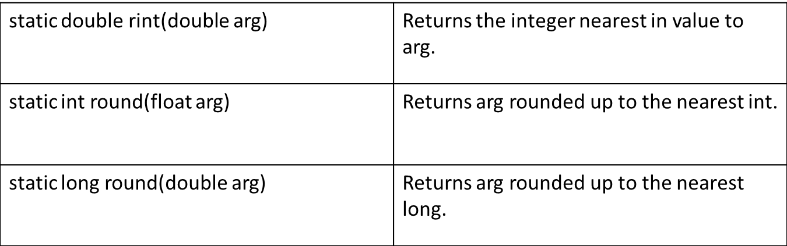
Rounding Functions

Slide 13
Miscellaneous Math Methods
Static double IEEEremainder(double dividend,double divisor)
returns the remainder of dividend/divisor
Based on IEEE 754 standard
Static double random()
returns a pseudorandom number(0 to 1)
Static double toRadians(double angle)
converts degrees to radians
Static double toDegrees(double angle)
convert radians to degrees

Slide 14
Example
Class Angles {
Public static void main(String args[]) {
double theta=120.0;
System.out.println(theta + “degree is”+Math.toRadians(theta)+ “radians”);
theta=1.312;
System.out.println(theta + “radians is”+Math.toDegrees(theta)+ “degrees”);
}
}
Output:
120.0 degrees is 2.0943 radians
1.312 radians is 75.1720 degrees

Slide 15
Process
The java.lang.Process class provides methods for performing input from the process, performing output to the process, waiting for the process to complete, checking the exit status of the process, and destroying (killing) the process.
Process class encapsulates the process-(i.e) an executing program.
It is primarily as a super class for the type of objects created by exec() in the runtime class.
Process contains the abstract methods.

Slide 16
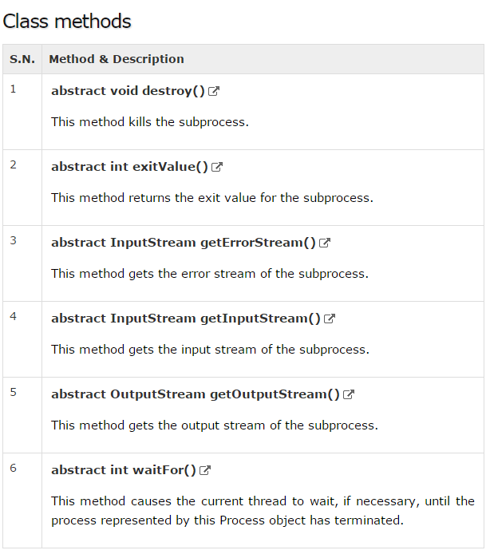

Slide 17
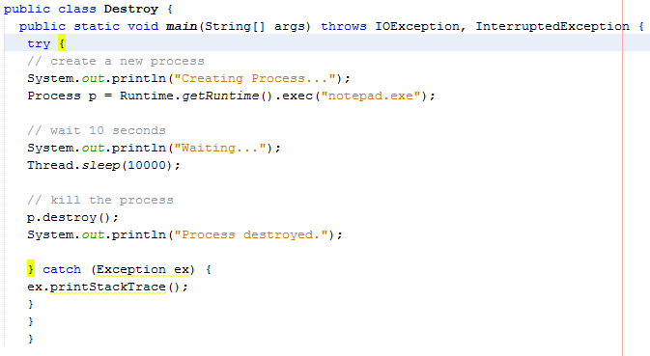
java.lang.Process
Process p = Runtime.getRuntime().exec(“notepad.exe”);

Slide 18
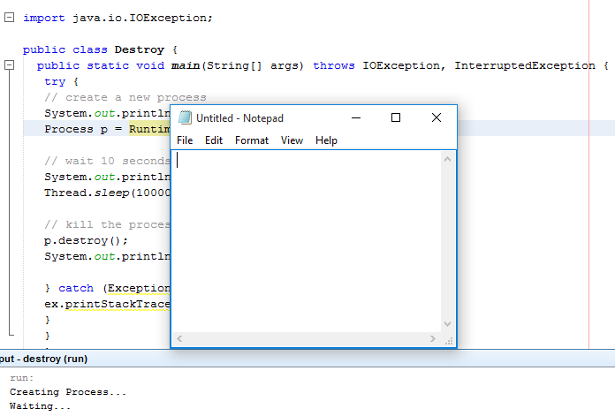
java.lang.Process
This method kills the subprocess. The subprocess represented by this Process object is forcibly terminated.
public abstract void destroy()

Slide 19
java.lang.Process.getErrorStream()
The method gets the error stream of the subprocess. The stream obtains data piped from the error output stream of the process represented by this Process object.
public abstract InputStream getErrorStream()

Slide 20
java.lang.Process.getInputStream()
The method gets the input stream of the subprocess. The stream obtains data piped from the standard output stream of the process represented by this Process object.
public abstract InputStream getInputStream()

Slide 21
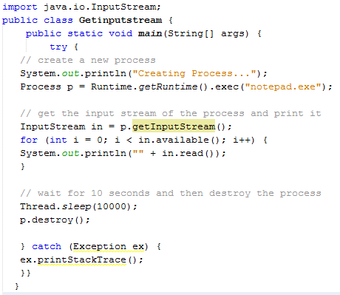
java.lang.Process.getInputStream()

Slide 22
java.lang.Process.getOutputStream()
The method gets the output stream of the subprocess. Output to the stream is piped into the standard input stream of the process represented by this Process object.
public abstract OutputStream getOutputStream()

Slide 23
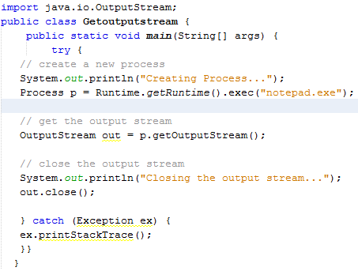
java.lang.Process.getOutputStream()

Slide 24
java.lang.Process.waitFor()
The method causes the current thread to wait, if necessary, until the process represented by this Process object has terminated.
This method returns immediately if the subprocess has already terminated.
If the subprocess has not yet terminated, the calling thread will be blocked until the subprocess exits.
public abstract int waitFor()

Slide 25
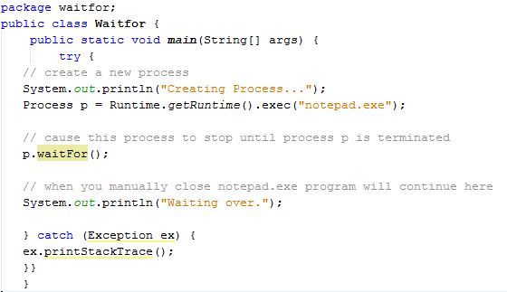
java.lang.Process.waitFor()

Slide 26
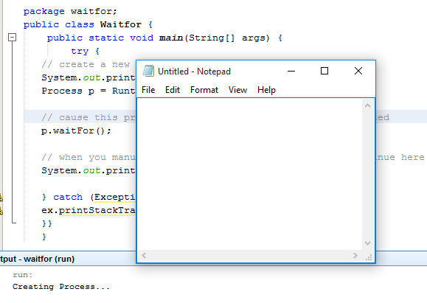
java.lang.Process.waitFor()

